Slide 1


INVITATION
Challenges and Changes in Asthma Management
What should clinicians know about options for add-on therapy and better asthma control
Date:
16th April 2019 (Monday)
Time:
6.00pm – 8.00pm
Venue:
Long Beach Seafood
IMM Building

Slide 2

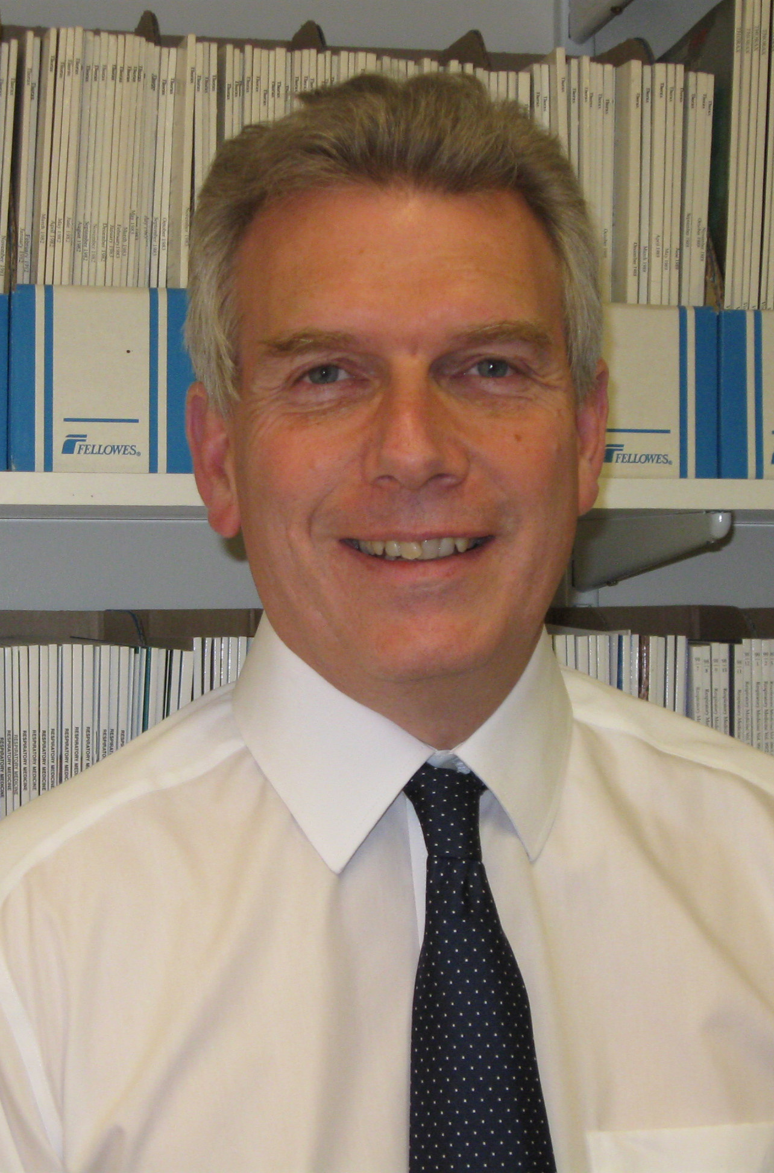
Programme
TIME
TOPICS
Professor Halpin is Consultant Physician and Honorary Associate Professor in Respiratory Medicine at the Royal Devon and Exeter Hospital, Exeter, UK. He has a busy clinical practice and was Clinical lead 2003-16.
He trained at Oxford University (first class honours); St Thomas Hospital Medical School, UK. He was awarded an MRC scholarship to undertake a D.Phil. in the Department of Human Anatomy, Oxford University, between his pre-clinical; clinical training. He trained in respiratory medicine at the Brompton Hospital, London.
He is a Fellow of Royal College of Physicians, Member British Thoracic Society,European Respiratory Society and American Thoracic Society. His research is focused on clinical aspects of COPD and asthma and he has published over 140 peer reviewed papers.
He lectures frequently around the world on COPD and asthma. He is a member of the Board of Directors of the Global Initiative on Obstructive Lung Diseases (GOLD) and of the GOLD Science Committee.
6.00pm
6.25pm
6.30pm
7.20pm
7.30pm
Registration
Opening remarks by Chairperson
What should clinicians know about options for add-on therapy and better asthma control
Prof Dr. David Halpin
Q&A
Continue with dinner (served during the lecture)
For Medical Professionals Only.
Boehringer Ingelheim Singapore Pte Ltd
300 Beach Road #37-00, The Concourse Singapore 199555.
Tel: 6419 8600 Fax: 6299 3083
PC-MY-100539 April 2019

